Slide 1
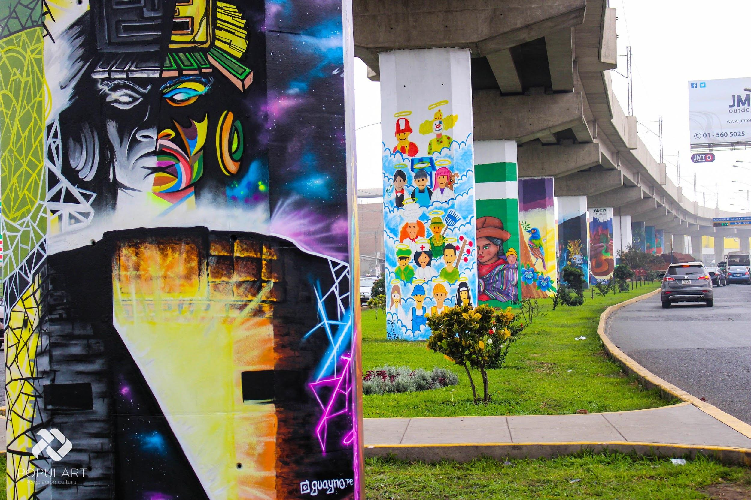
STREET ART PERÚ
PopulART Proyect

Slide 2
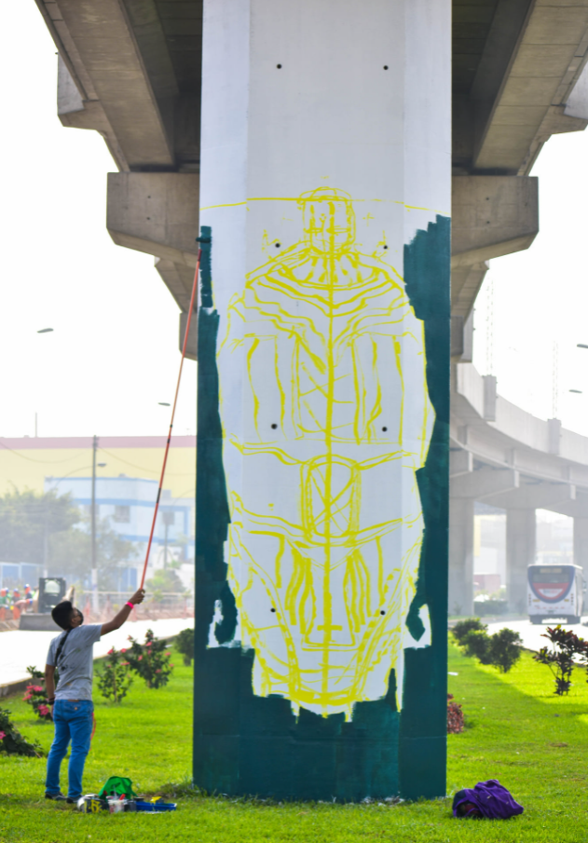
¿WHY PAINT?

Slide 3
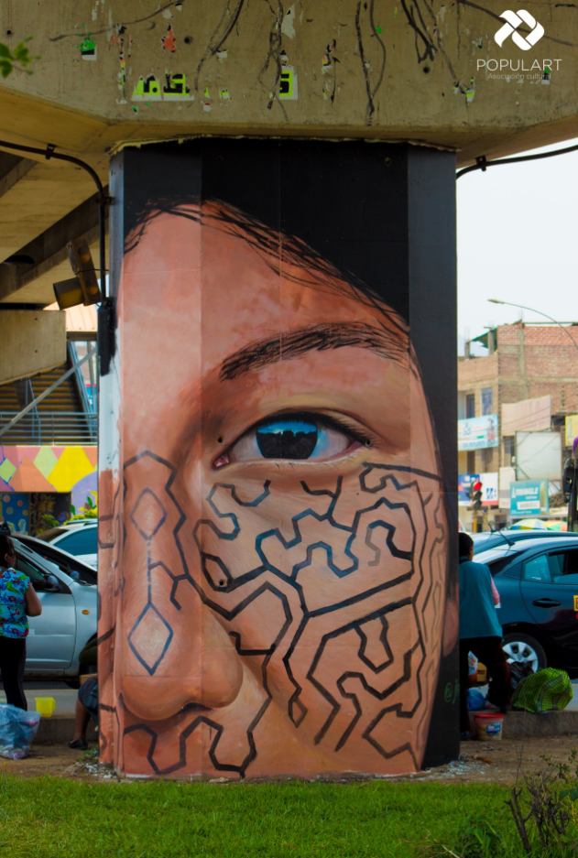
“PERÚ ON
CONCRETE”

Slide 4
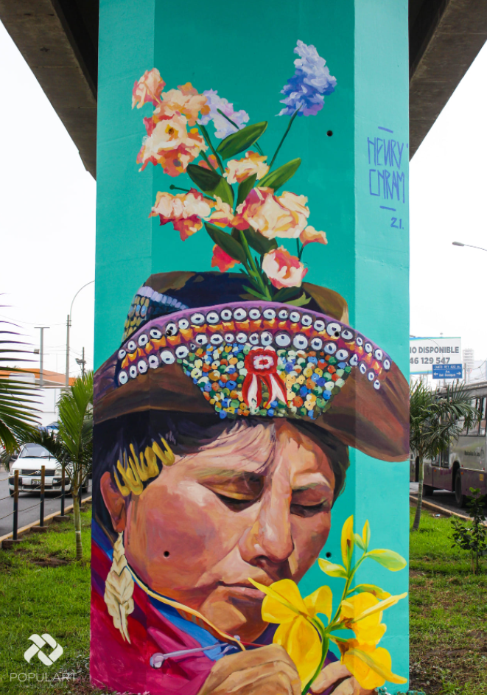
Vandal act? Misfit youth?

Slide 5
CONTENTS
01
02
REVIEW
ART ON SJL
03
04
ACTUAL STATE
BICENTENNIAL PLAN
Actions, and future proposals
INTERVENTIONS
Evaluating some results
Improvement proposals.
Urban Art Gallery in San Juan de Lurigancho

Slide 6
San Juan de Lurigancho
Yes, we already know that the district with the largest population nationwide, that there are different artistic, cultural, social and environmental manifestations, among others, and that there is a patrimonial and natural legacy.
What is the next step?

Slide 7
—Muñiz
“When one thing becomes another, it is the most beautiful moment. A combination of sounds is transformed into music. And the same happens with everything. That moment is pure magic”

Slide 8
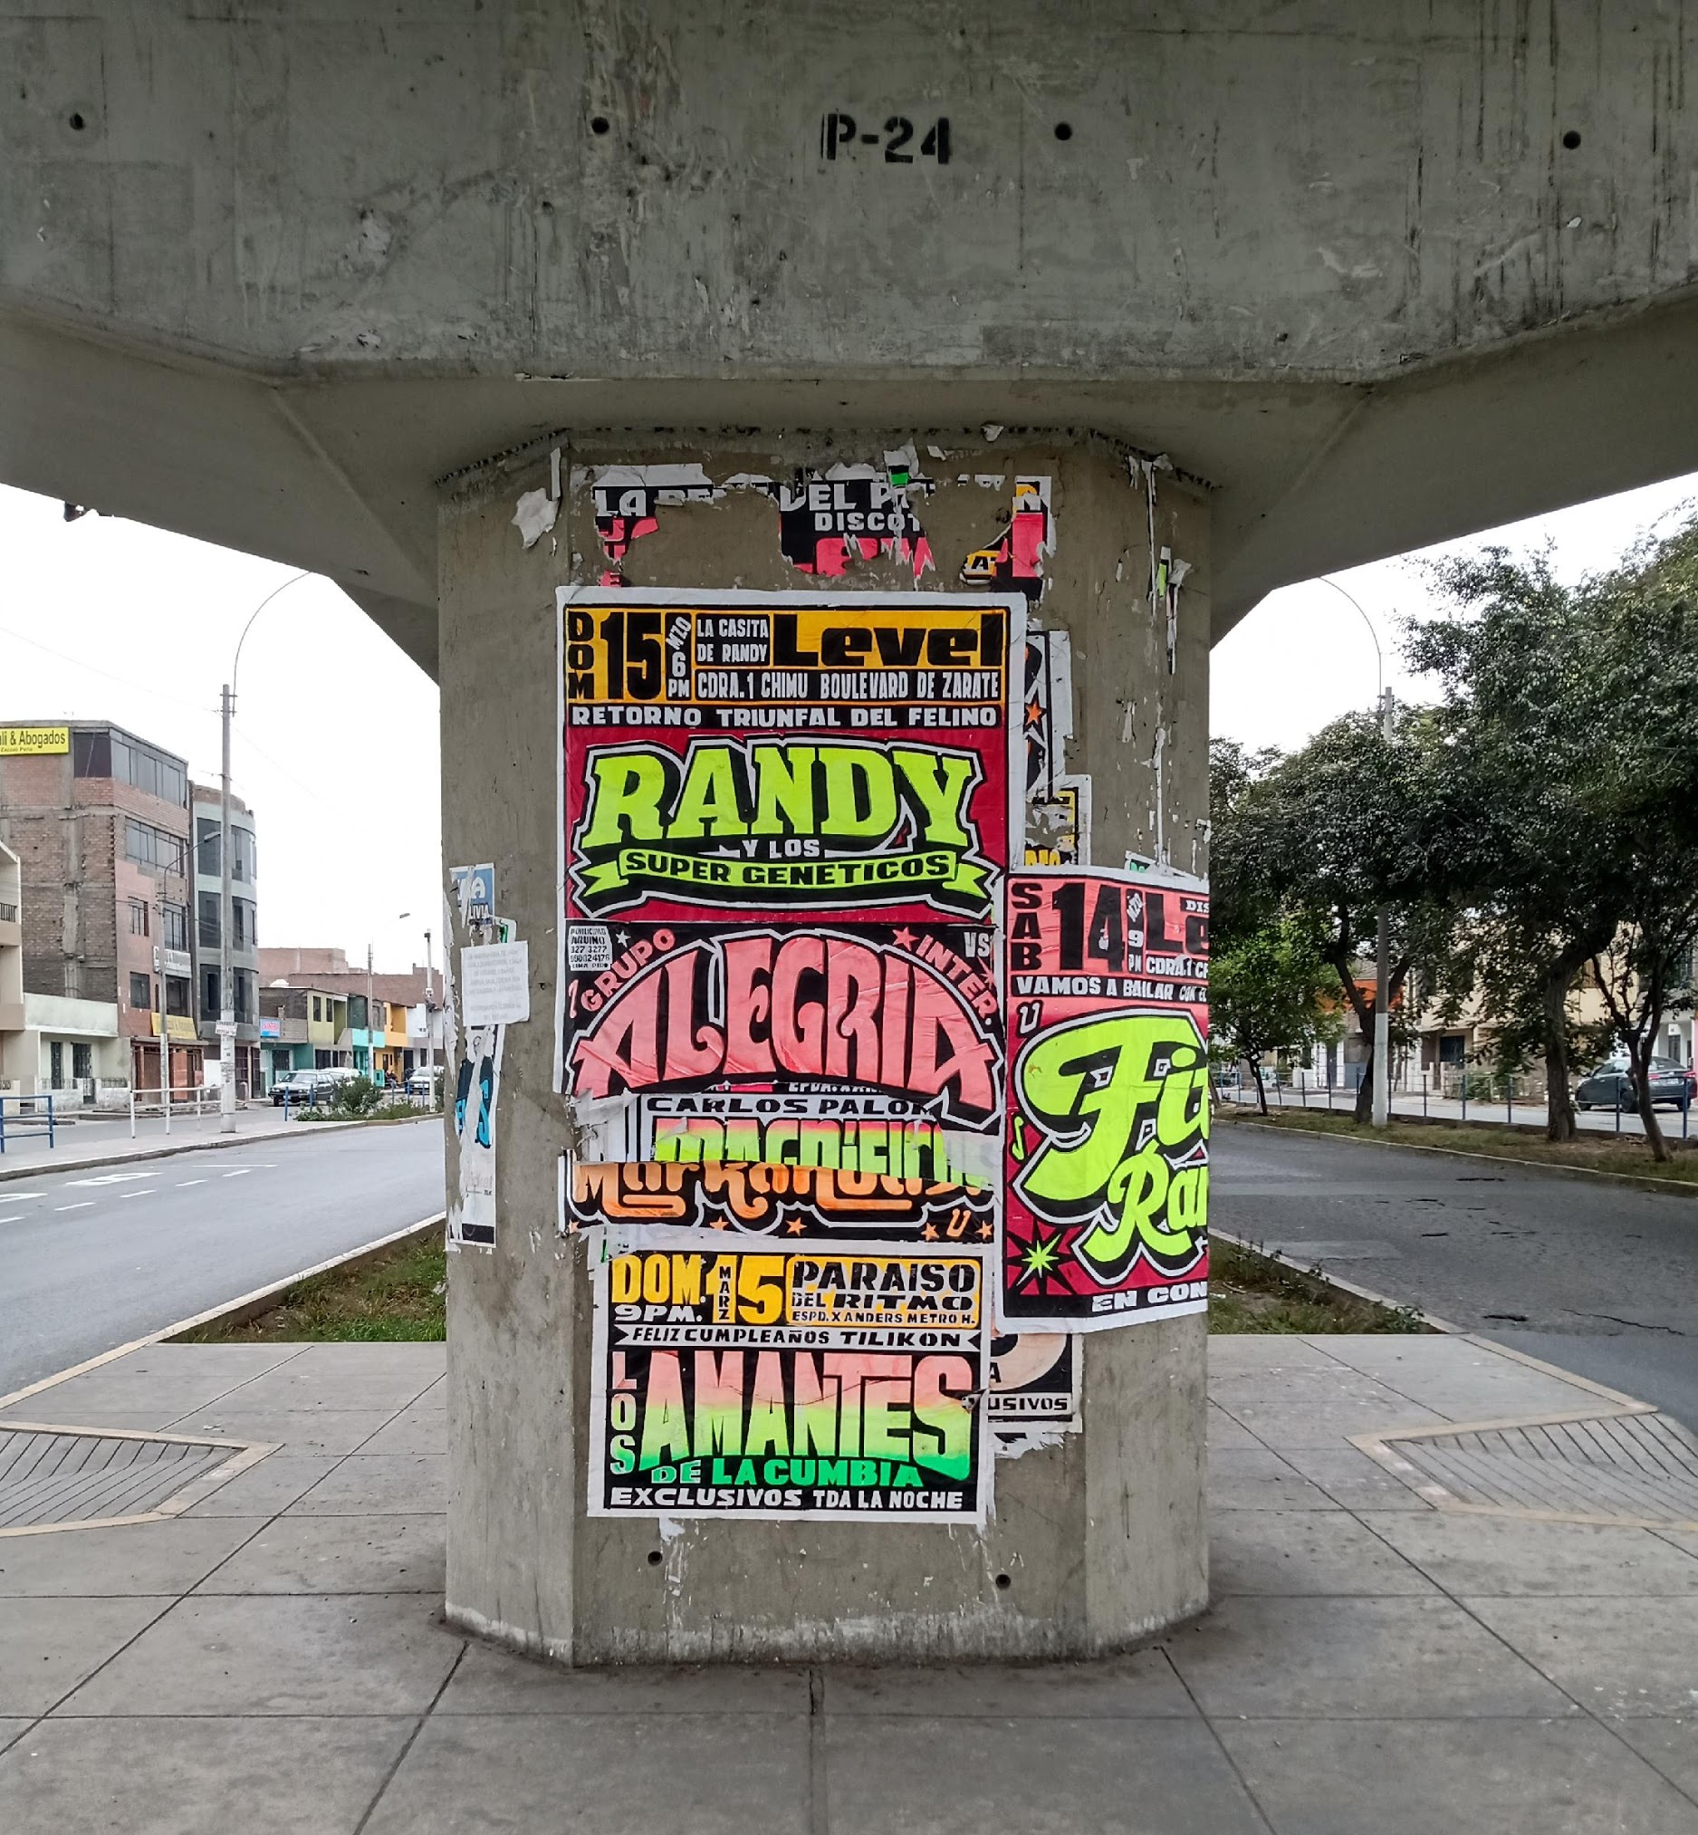
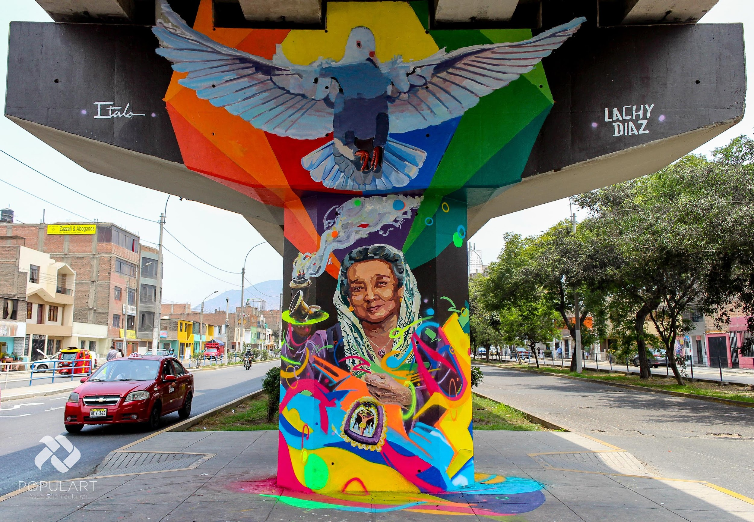
BEFORE
AFTER

Slide 9
REVIEW
Democratize ART
1.- Educational.
2.- Accessible.
3.- Sustainable.

Slide 10
ART IN SJL
PLASTIC ARTS
MURALS
EDUCATION
36 PICTURES OIL ON CANVAS
4 EXHIBITIONS OF ITINERANT ART
2 TEMPORARY EXHIBITIONS IN GALLERY
392 ARTS IN COLUMNS.
72 COLLABORATIVE ARTS.
98 ARTS OF OTHER ORGANIZATIONS *
1 ARTS PROGRAM. (AUREA)
14 ART WORKSHOPS.
16 ACADEMIC DISSEMINATION.
*Conteo aproximado de obras en espacios públicos

Slide 11
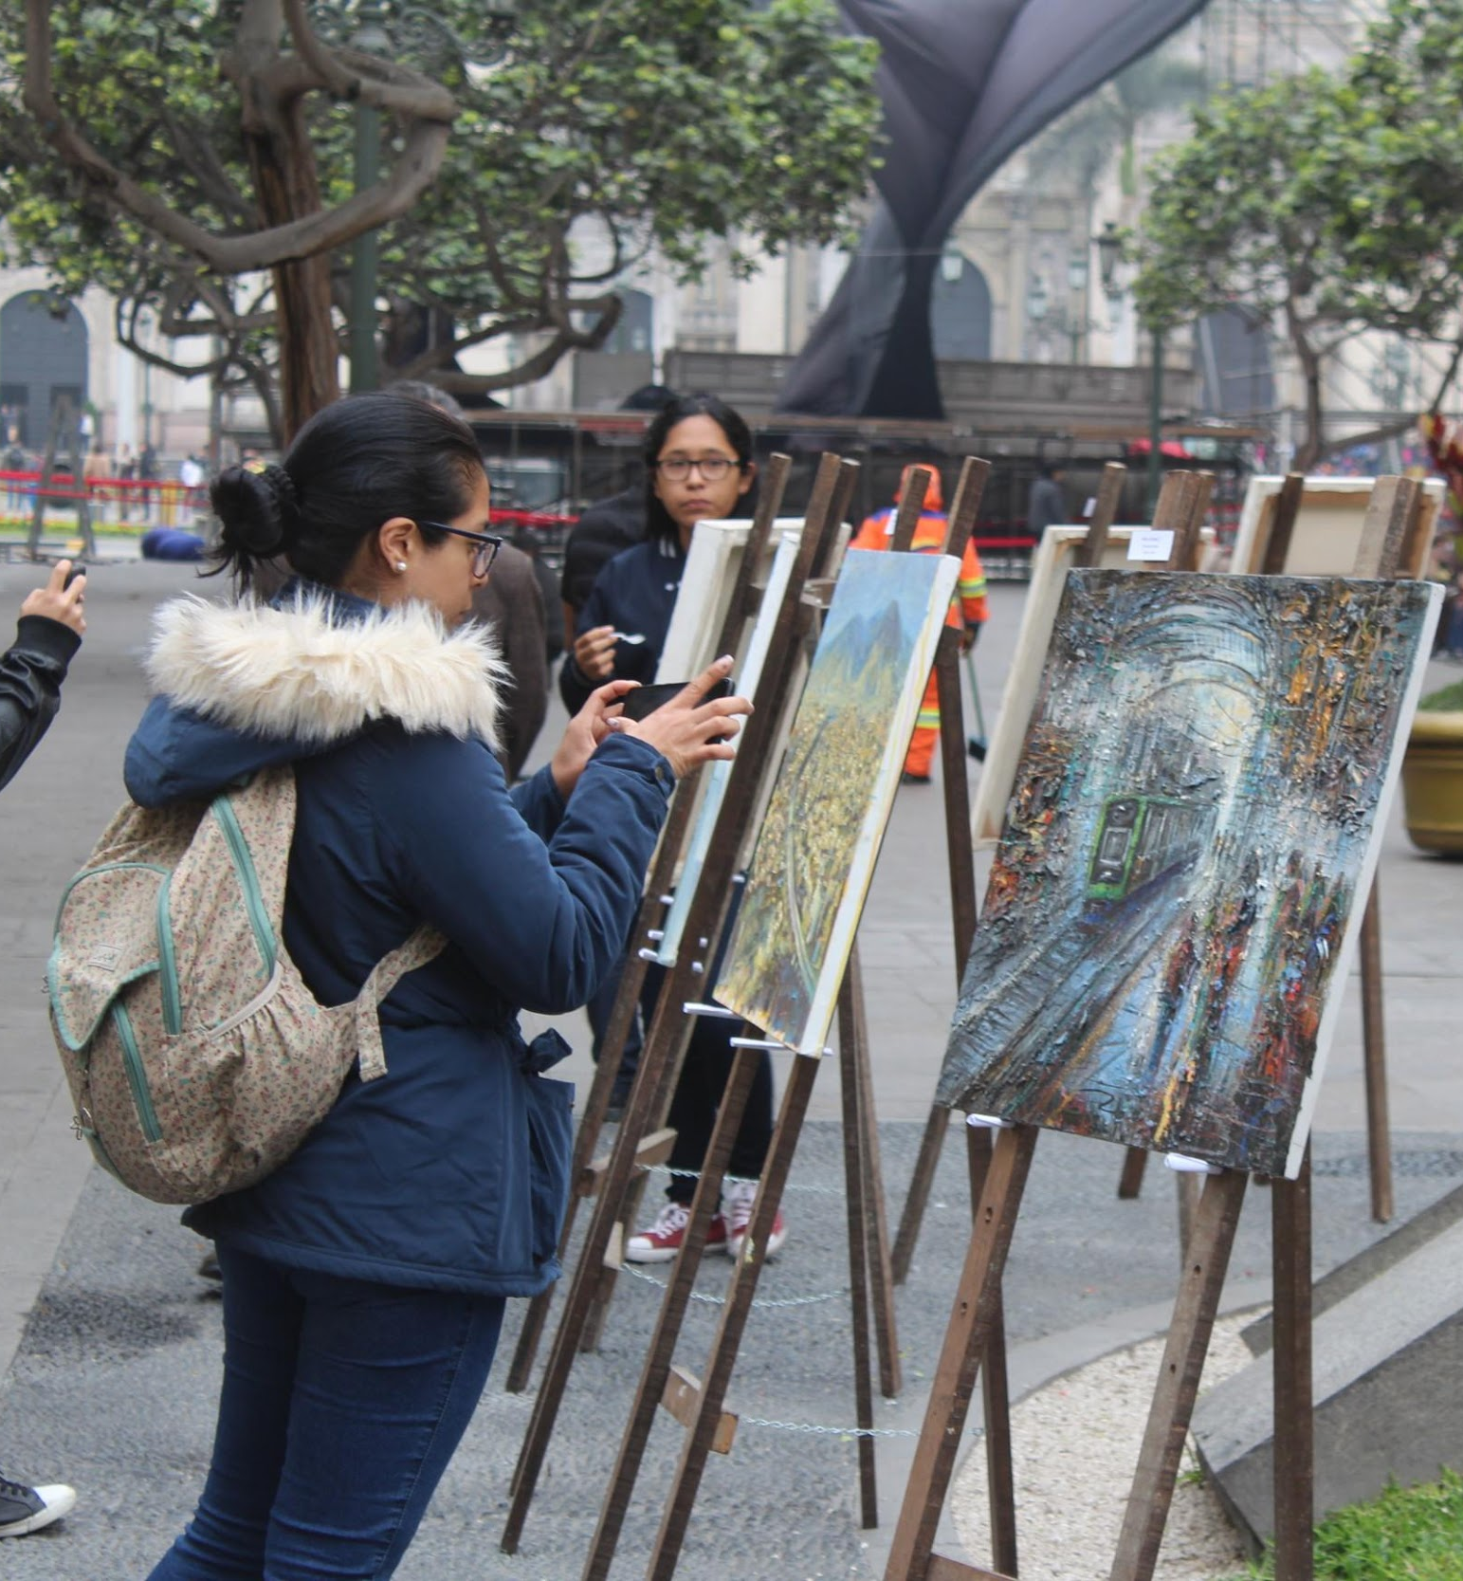
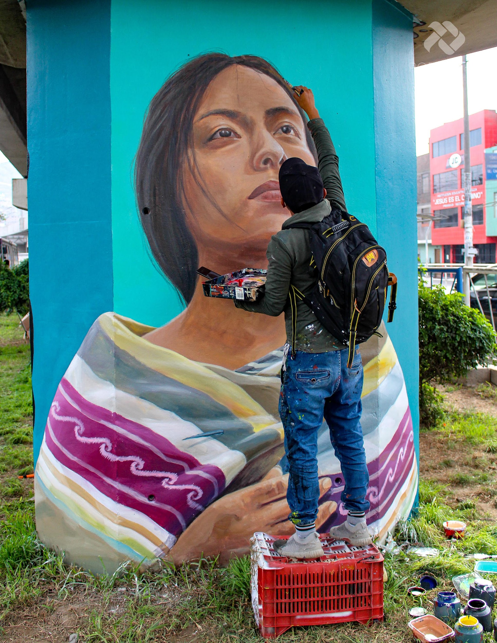
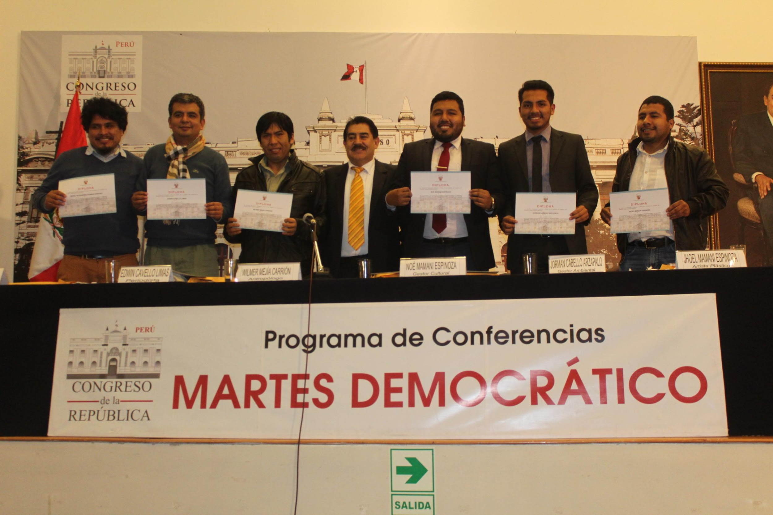
EXPO ITINERANTE SAN JUAN INSPIRA
DAMA DEL SAUCE POR JEANKLO
LECTURE ON SJL AT THE CONGRESS

Slide 12
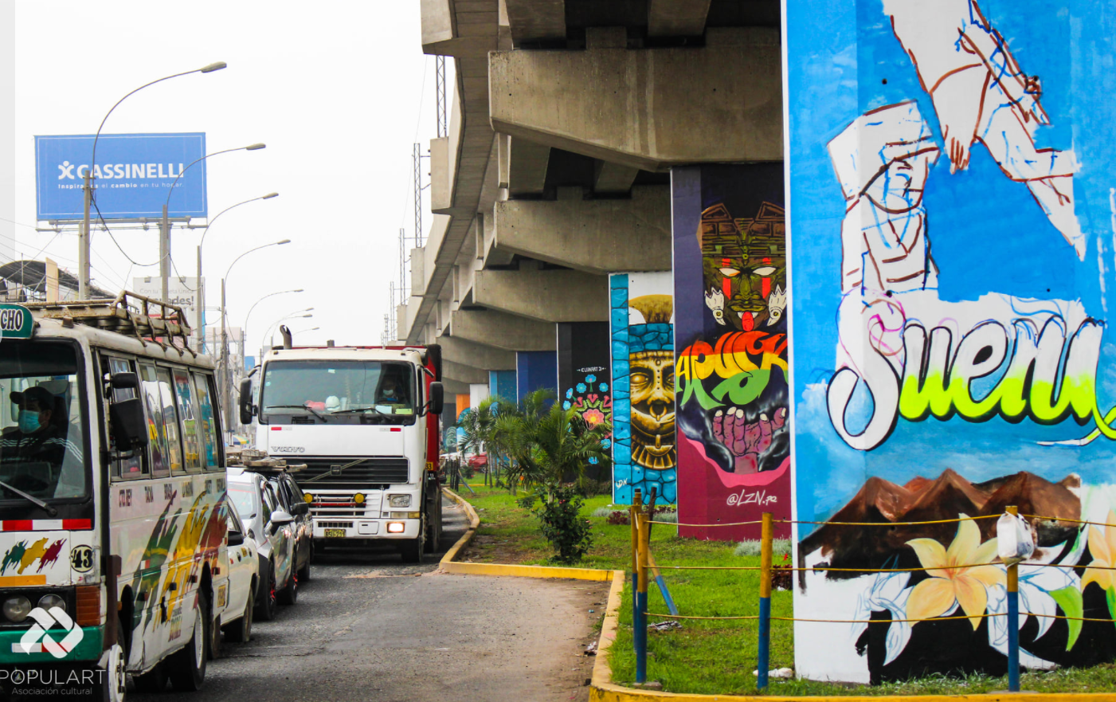
MURALISM IN SJL

Slide 13
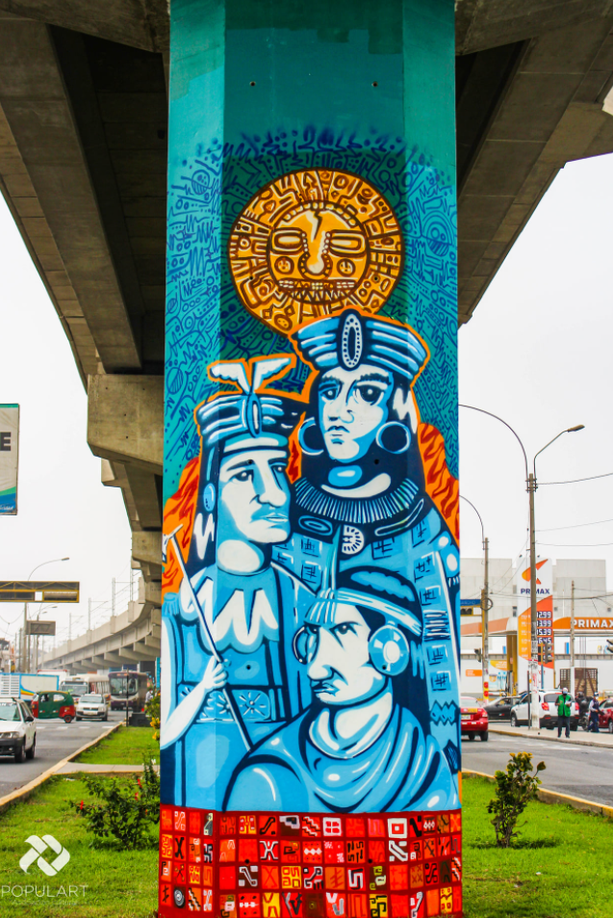
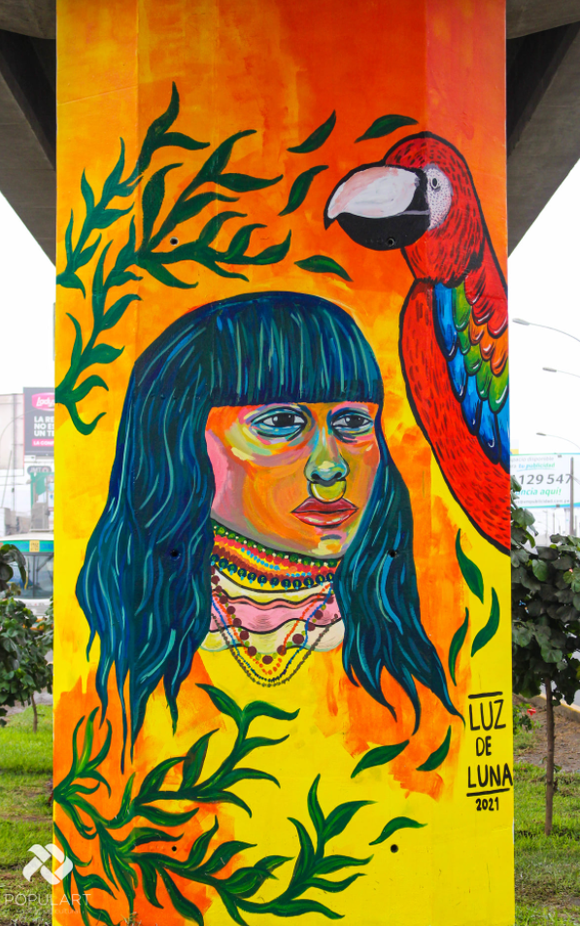

Slide 14
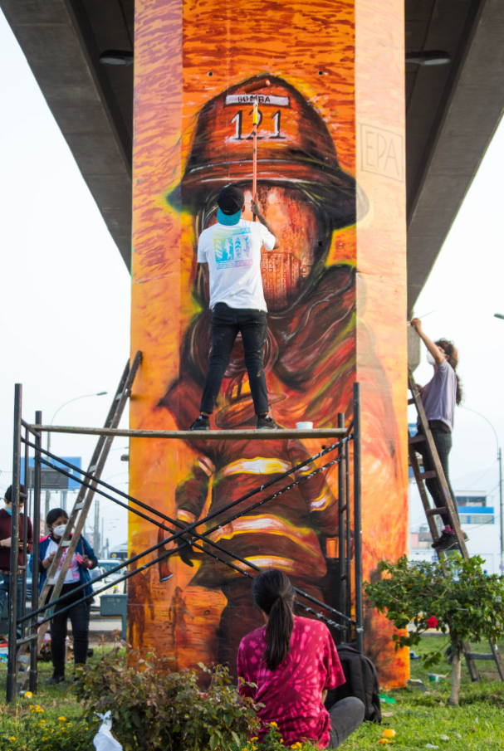
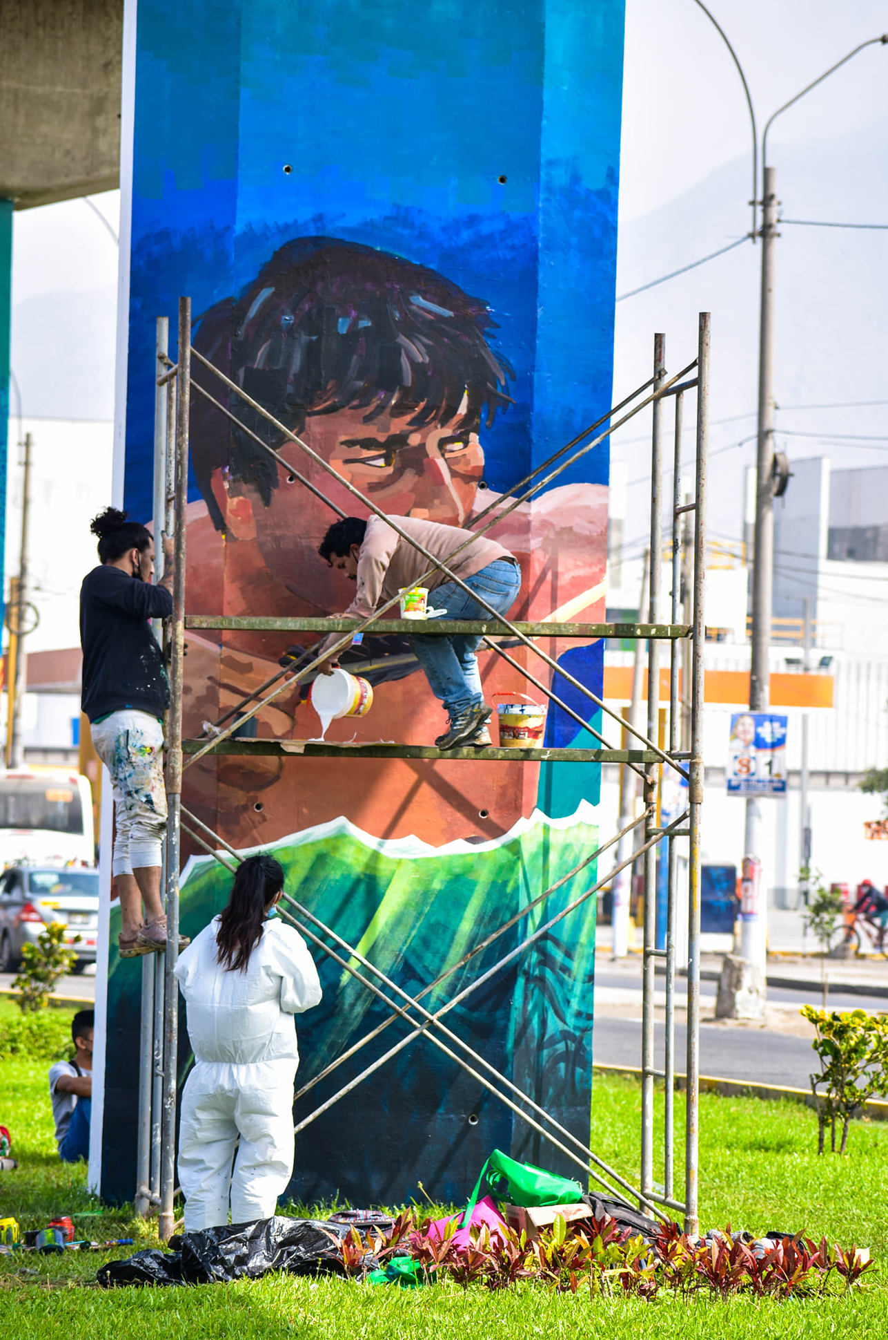

Slide 15
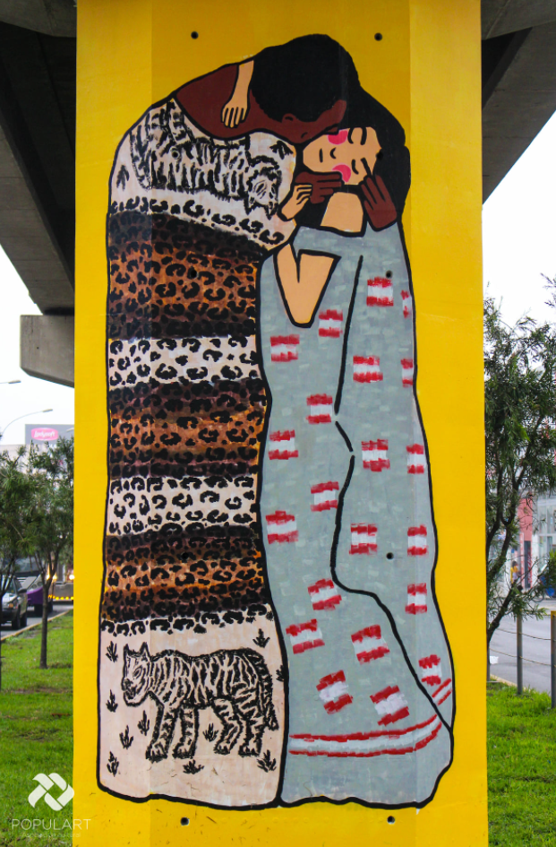
INSPIRTION
BLUE STEF
“Urban art refers to all street art and has no established canons.”

Slide 16
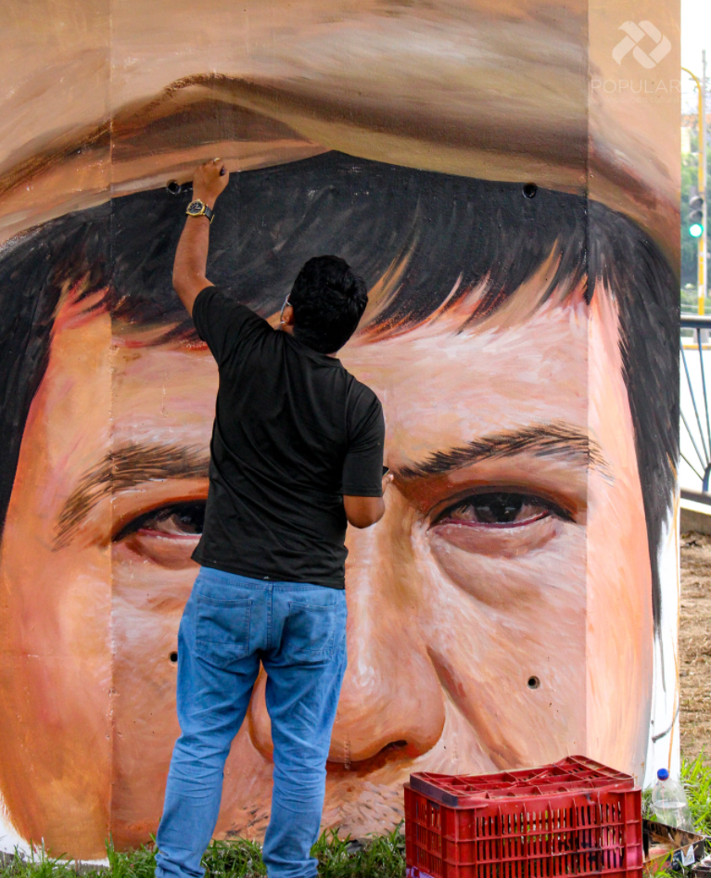

Slide 17
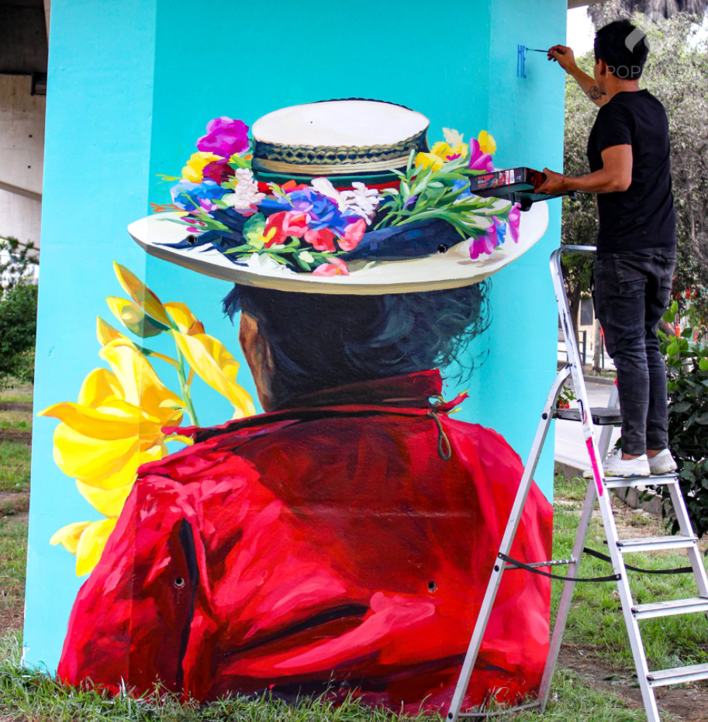

Slide 18
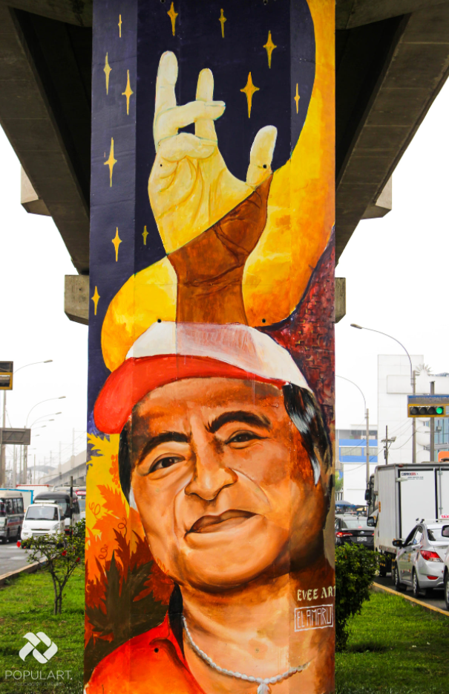
MEMORY
ELMER LOPEZ GARCÍA

Slide 19
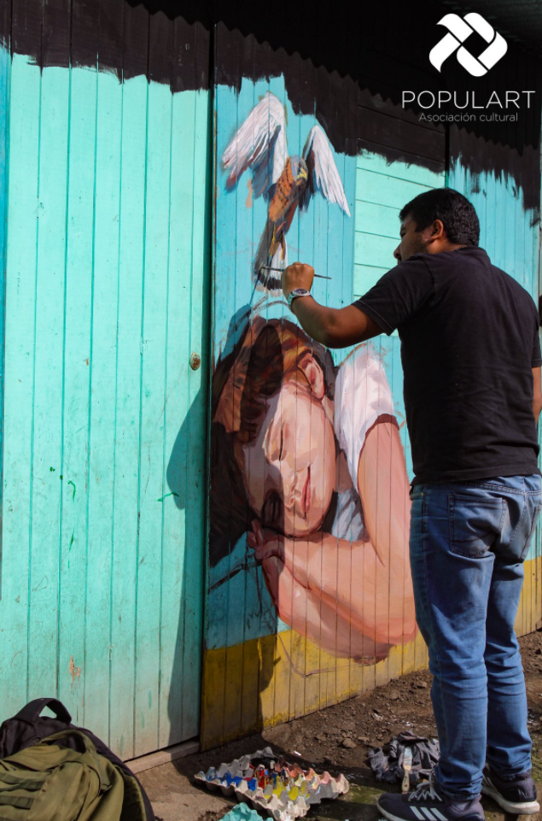
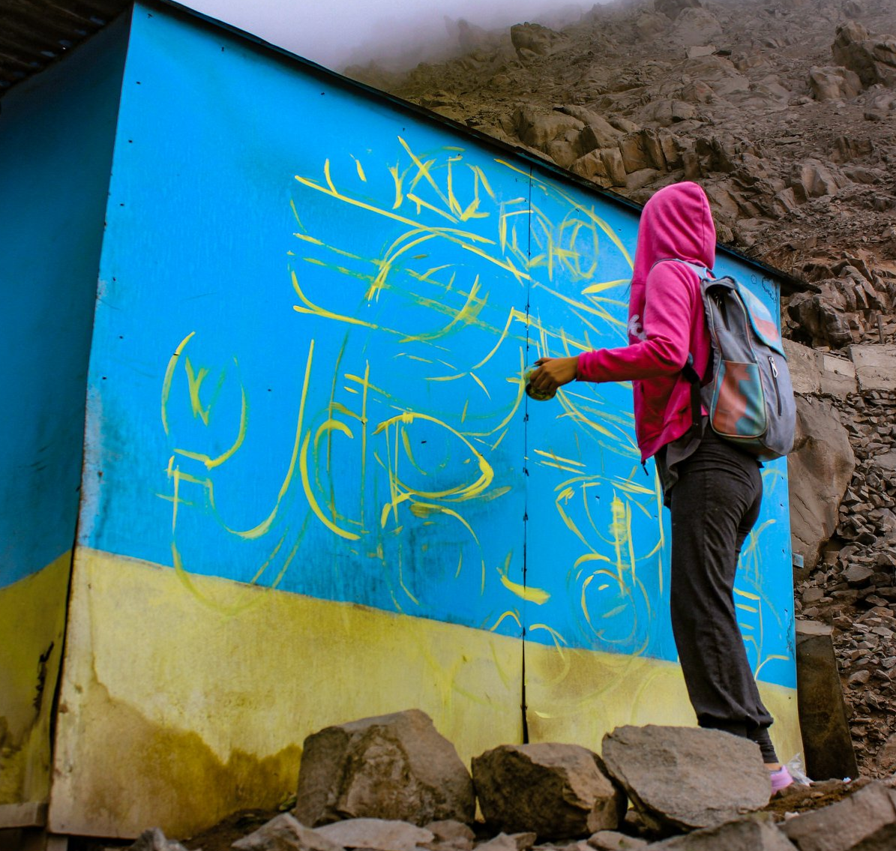
INTEGRACIÓN

Slide 20
ESTADO ACTUAL
412 ARTIST
INVOLVED
MAN
191 BELONGS TO SJL
512 ATTENDEES TO ACADEMIC EVENTS
WOMAN
LGTBIQ+
SOME DATA
SAN JUAN DE LURIGANCHO WILL HAVE THE FIRST MOST EXTENSIVE URBAN ART GALLERY IN THE REGION
158 AUTODIDACT
82 ENSABAP
17 PRESS RELEASES
2km
98.7%
Mural art aprox
122 WORKSHOP
BENEFICIARIES
Approval of actions in social and physical networks

Slide 21
ACTUAL CONDITION
CONDITION
IMMEDIATE ACTION 2021
45 DAMAGED WALL ART (MEONES, POSTERS AND NEGLIGENCE)
MAINTENANCE
SCHOOL OF ART - ÁUREA
VIRTUALIZATION PROPOSAL
WORKSHOPS AND CONVERSATIONS
VIRTUALIZATION PROPOSAL

Slide 22
BICENTENNIAL PLAN
CONTEST
URBAN ART GALLERY
WEB SITE
MACROMURAL
QUICK PAINTING, WALLS, DRAWING, INTERSCHOOLS, OTHERS
OUTDOORS, THEMATIC GUIDES, DISSEMINATION
DISSEMINATION OF ART, ARTISTS, NEWS, MARKETPLACE, OTHERS ..
COMMUNITY ACTION

Slide 23
THANK YOU

